Slide 1
Implementation of Median Filter on Z -Board and AWS
Reconfigurable Computing – Project.
By,
Anushka Swarup,
Medini J. Aradhya
Liming Xu

Slide 2
I. Project Description :
The Median Filter is a nonlinear digital filtering technique for removal of noise from images.
It works particularly well for certain types of random noises like the salt and pepper noise.
This method is often used as a preprocessing step for edge detection algorithms. It is advantageous as this method better preserves the edges in certain instances.
The amazon web services cloud platform is compatible with existing FPGA algorithms hence makes it a versatile open source platform for accelerated computing.
Notes:
anushka

Slide 3
II. Software Algorithm – MATLAB
Medfilt2() – 2D Median Filtering
J = medfilt2(I)
performs median filtering of the image I in two dimensions.
Each output pixel contains the median value in a 3-by-3 neighborhood in the input image.
Notes:
anushka

Slide 4
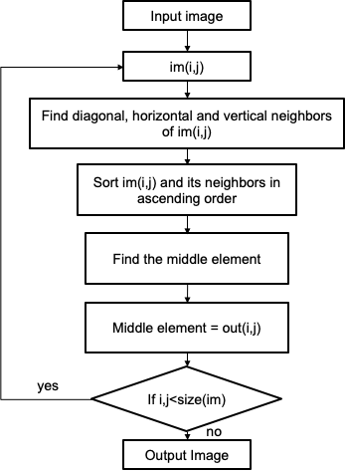
Software Algorithm – C++
■Input image of size 128x128 was used
■A 3x3 window was obtained at each pixel
■Insertion sort algorithm was used to arrange the window in ascending order
Notes:
anushka

Slide 5
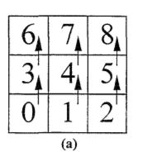
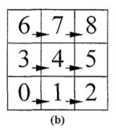
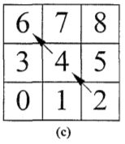
III.Hardware Algorithm
Sort the pixels vertically with triple sorters
Sort the pixels horizontally
Sort accross the diagonal in the middle
The center of the square is the median
Vertical Sort
Horizontal Sort
Diagonal Sort
Notes:
Liming

Slide 6
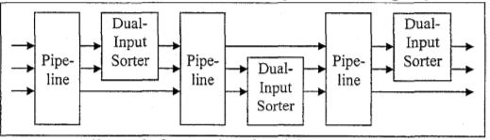
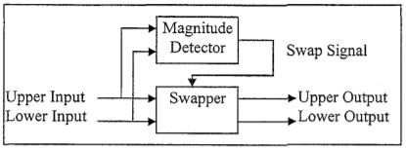
Hardware Algorithm
Notes:
Liming

Slide 7
IV. Datapath Details :
First stage: 3*triple sorter in parallel, sort vertically
Second stage: 3*triple sorter in parallel, sort horizontally
Third stage: 1*triple sorter to sort diagonally
Latency: 3 stages*3 cycles per stage = 9 cycles
Notes:
Liming

Slide 8
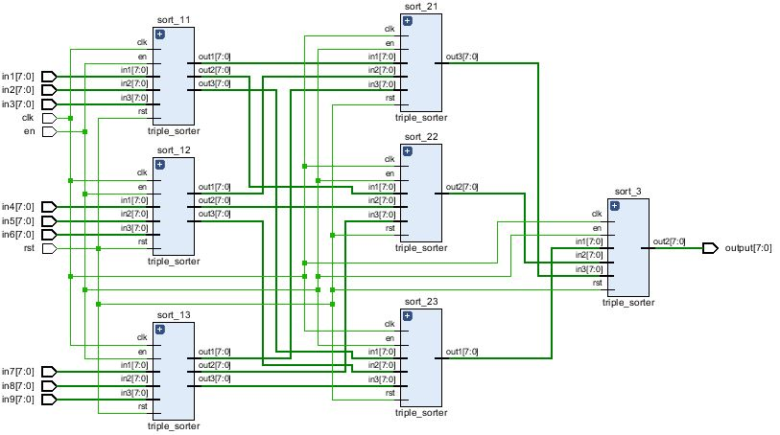
V. Design and Implementation
Datapath:
Notes:
Liming

Slide 9
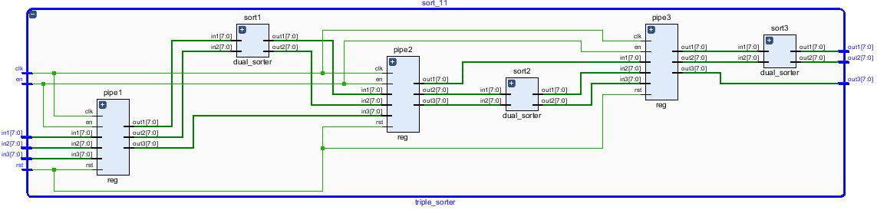
Design and Implementation
Datapath:
Notes:
liming

Slide 10
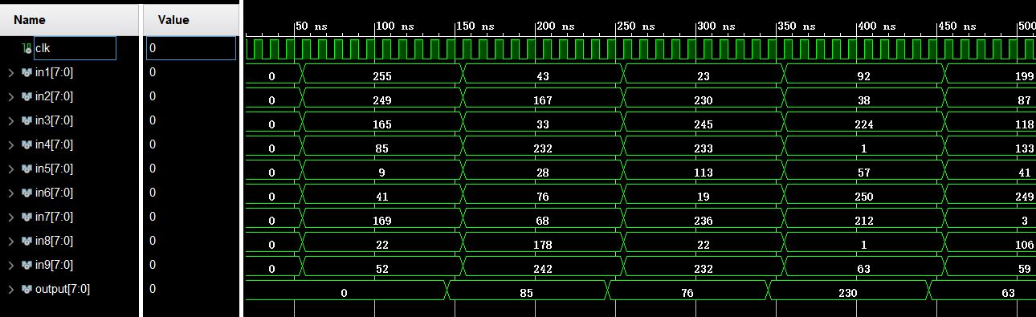
Design and Implementation
Datapath:
Latency: 3*3=9 cycles
Notes:
Liming

Slide 11
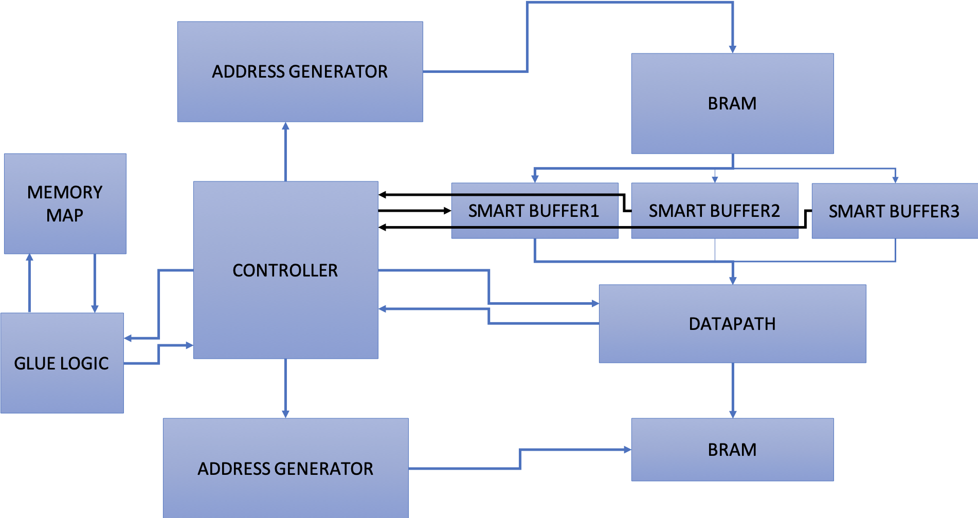
VI. Block Diagram
Notes:
liming

Slide 12
Hardware limitation:
Address is represented by 15 bit vector, thus the size of the image cannot exceed 2^15 words (131kB)
Notes:
liming

Slide 13
Design and Implementation - AWS
■ Xilinx FPGAs are available in the Amazon Elastic Compute Cloud (Amazon EC2) F1 instances.
■With F1 instances you can:
→ deploy custom hardware acceleration
→ Use your existing FPGA algorithms
Tool Used with AWS-F1 is SDAccel.
Notes:
Medini

Slide 14
Design and Implementation - AWS
Structure:
Create F1 Instance on AWS.
Create Storage bucket and Private connection keys.
Launch EC2-F1 Instance
Connect to it via PuTTy with the connection keys.
Set up GUI on the instance ( Since AWS FPGA Developer AMI does not include GUI )
→ Hence connect to the RDP Client where the instance is running Centos 7 and the FPGA Developer AMI.
Configure the instance for working with SDAccel ( By create groups> users> add permissions > get authentication details >
Notes:
Medini

Slide 15
Design and Implementation - AWS
6) Configure the SDAccel Environment :
→ Execute the following commands from the command line of the instance terminal:
git clone https://github.com/aws/aws-fpga.git $AWS_FPGA_REPO_DIR
cd $AWS_FPGA_REPO_DIR
source sdaccel_setup.sh
7) Create and compile a project to create “.xclbin” file
Import the necessary files for the project ( .ocl, .cpp, input files and binary files) Run the Emulation to verify the functionality of both SW and HW then perform a system run to generate the file to run on the FPGA board.
8) Run the “.xclbin” file via the terminal to execute the project on the FPGA.
Notes:
Medini

Slide 16
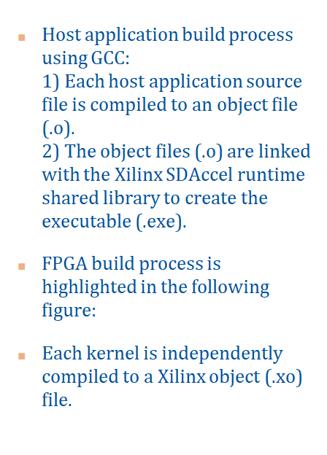
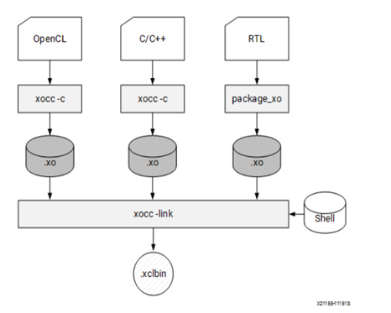
.xclbin file build process.
Notes:
medini

Slide 17
VII. Testing & Demonstration – Software
A set of popular test images were used to compare the results of the MATLAB function and the C++ code
In the final presentation, results from the MATLAB function will be used for visual comparison with the hardware results
Whereas, results from the C++ code will be used to compare the speedup with the hardware implementation
Notes:
Anushka

Slide 18



VIII. Dataset Used
Notes:
Anushka

Slide 19
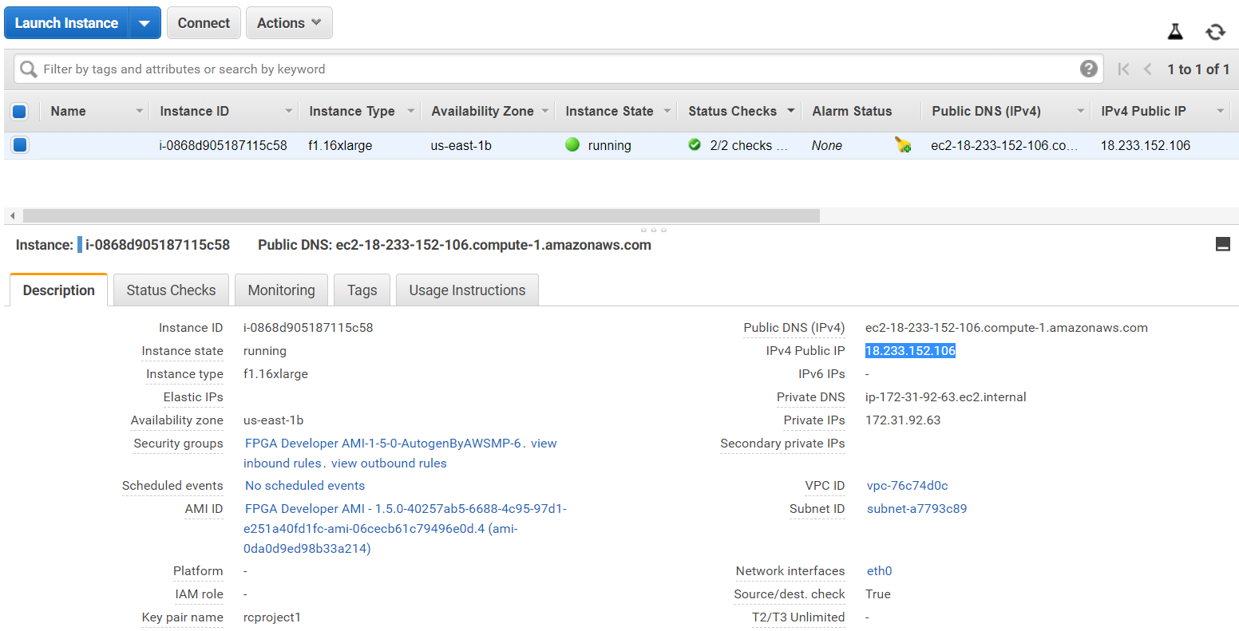
Testing & Demonstration – AWS
Notes:
Medini

Slide 20
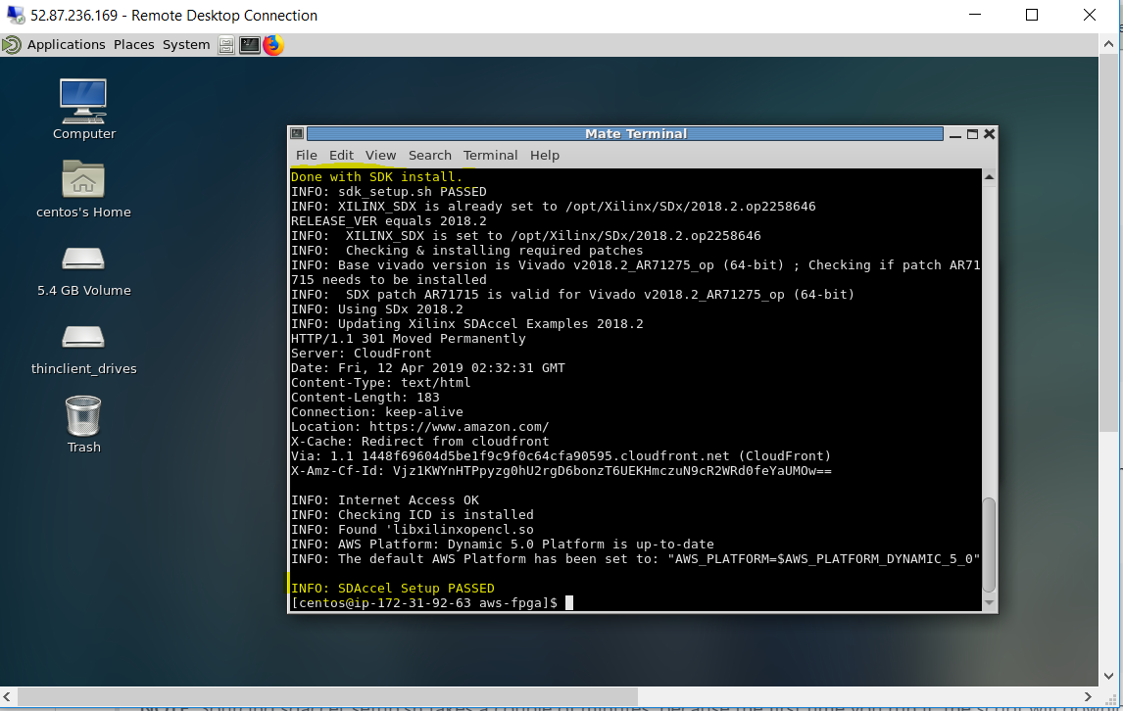
Testing & Demonstration – AWS
Connected to the RDP Client where the instance is running Centos 7 and the FPGA Developer AMI. + SDx Setup
Notes:
Medini

Slide 21
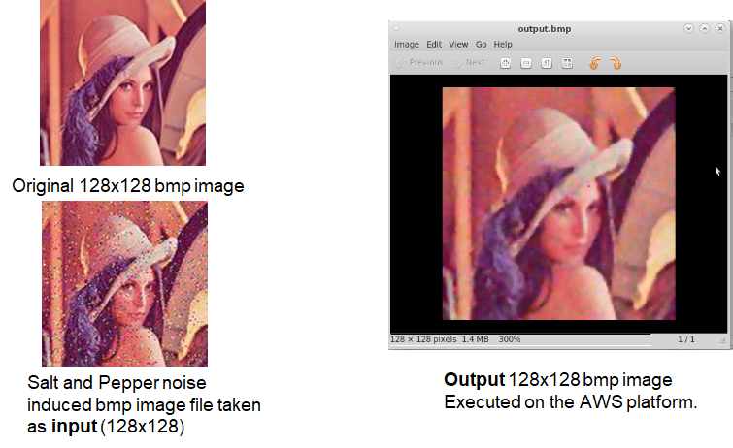
IX. Results – HW AWS
Notes:
medini

Slide 22
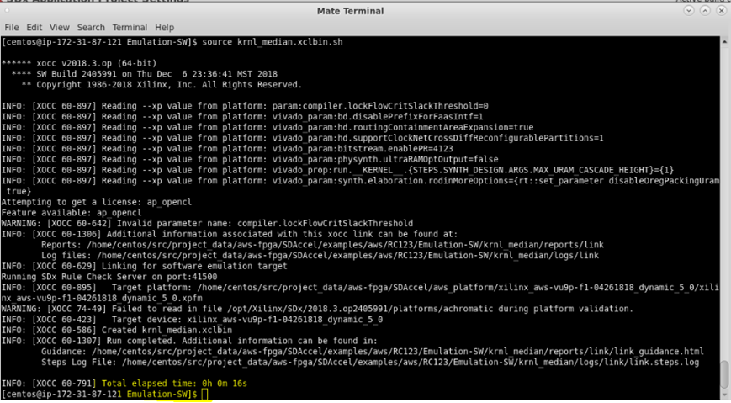
■As observed in the last few statements the SW emulation is run in 16sec. This is inclusive of build time.
Notes:
medini

Slide 23
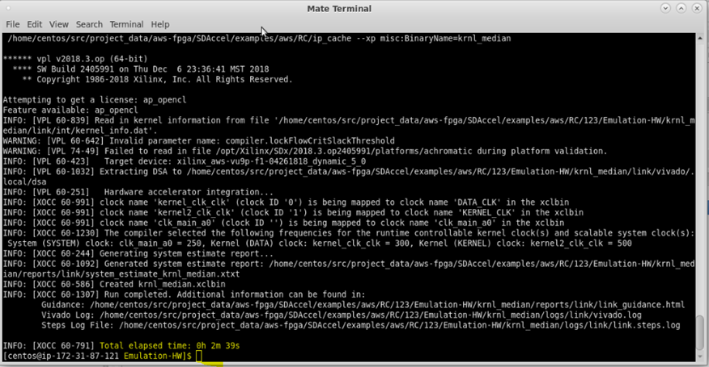
■As observed in the last few statements the HW emulation is run in 2m 39sec. This is inclusive of build time which seems to be considerable in this case. ( HW implementation should have lower time than SW implementation )
Notes:
medini

Slide 24
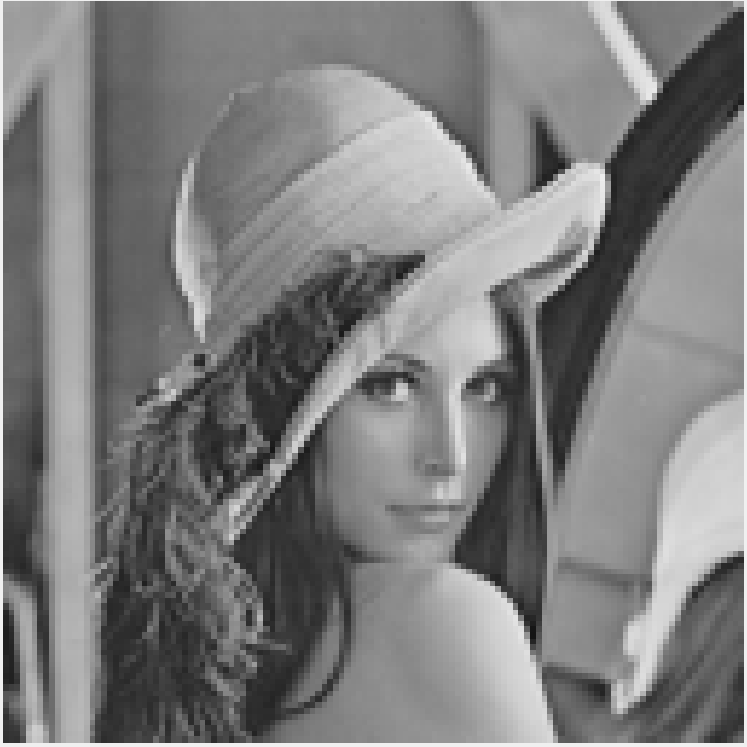

Results – MATLAB
Original Image (128X128)
Output Image - medfilt2() (128X128)
Notes:
Anushka

Slide 25
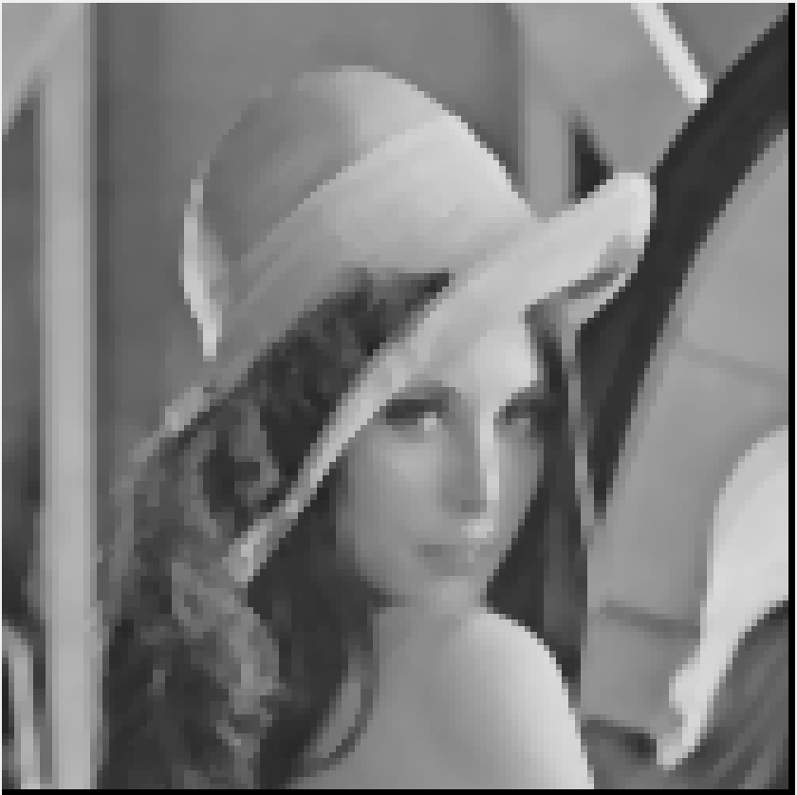
Results – C++
Original Image (128X128)
Output Image - C++ (126X126)
Notes:
Anushka

Slide 26
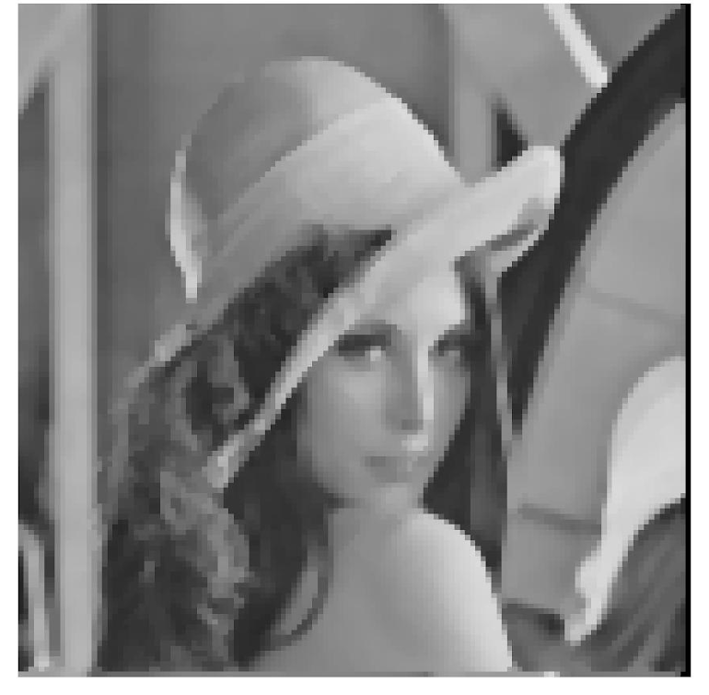
Results – Hardware
Original Image (128X128)
Output Image - Hardware Implementation (128X128)
Notes:
Anushka

Slide 27

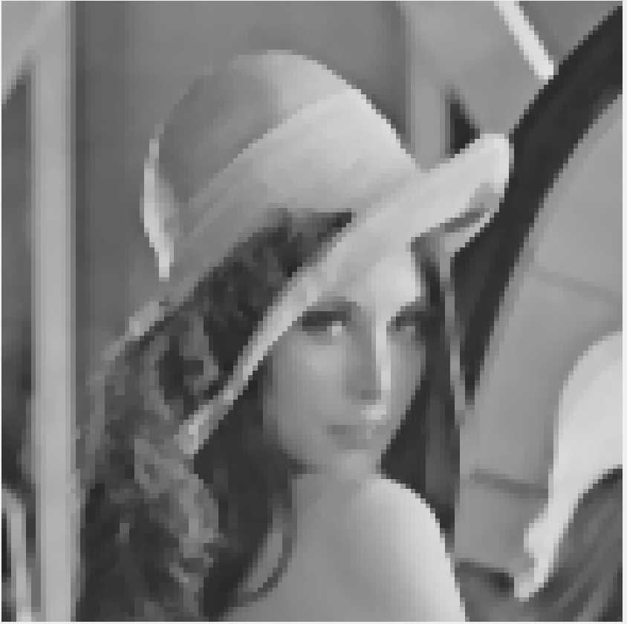
MATLAB vs Hardware Output
Notes:
Anushka

Slide 28
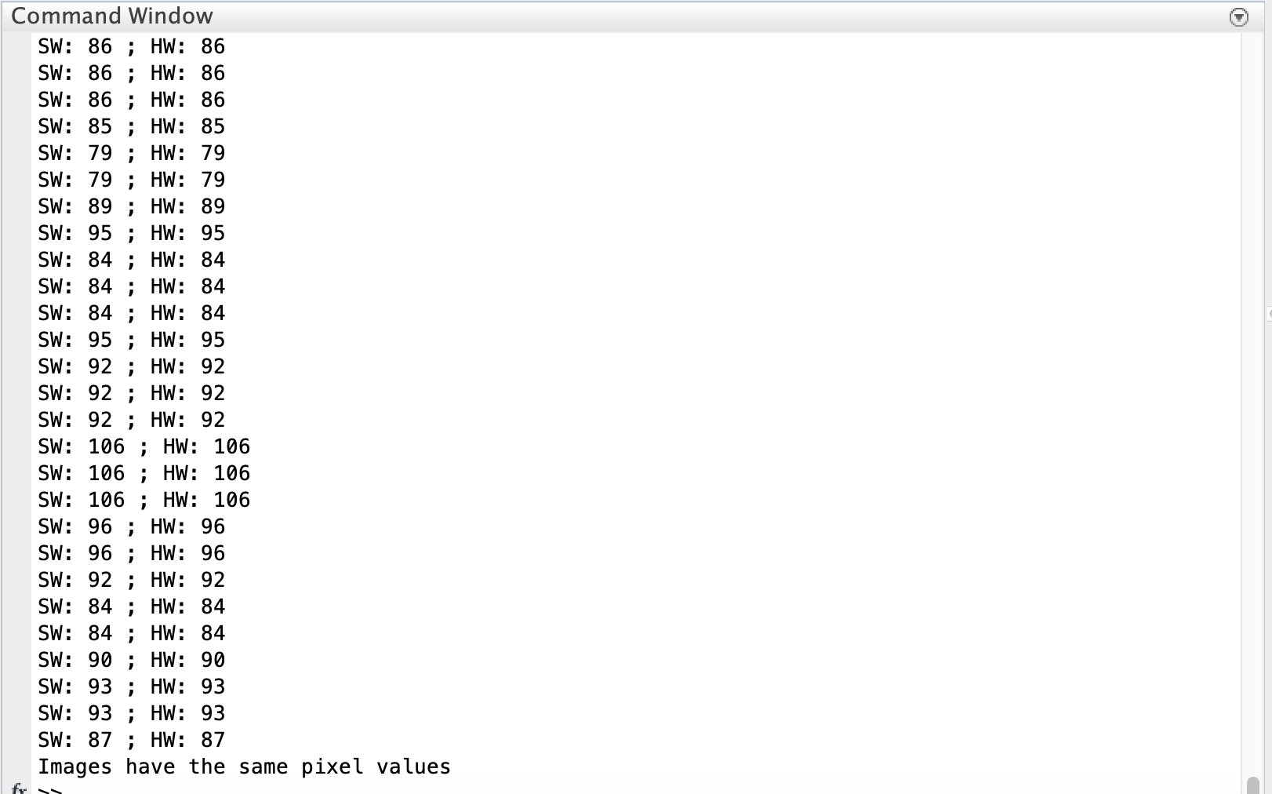
MATLAB vs Hardware Output
The hardware and matlab output are the same
Notes:
Anushka

Slide 29
C++ vs Hardware Output
Hardware speed up: 9.77
Hardware speed up without IO: 176.15
Notes:
Anushka

Slide 30
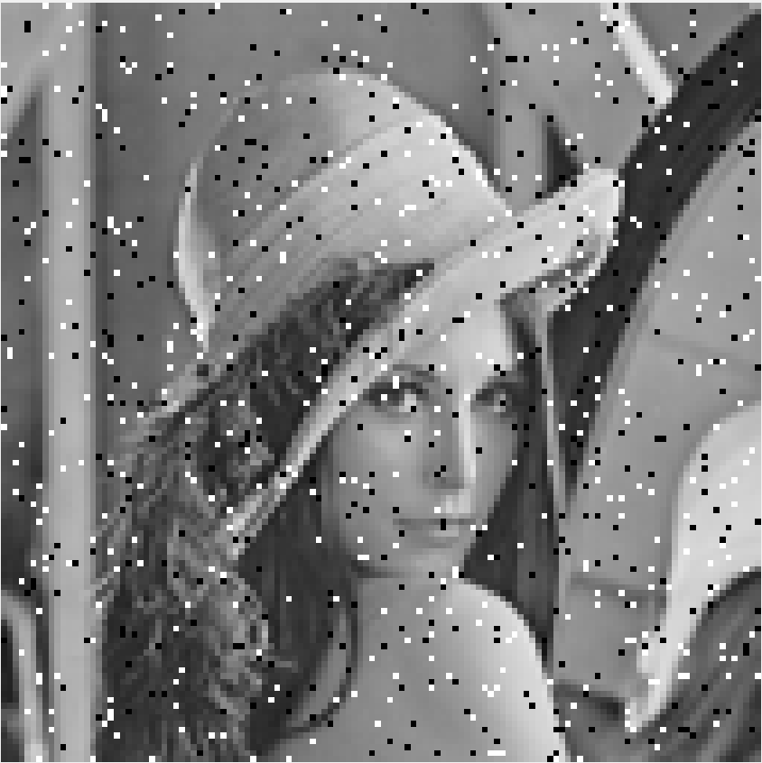

Salt & Pepper Noise
Input Image – Salt & Pepper Noise (128X128)
Output Image - medfilt2() (128X128)

Slide 31
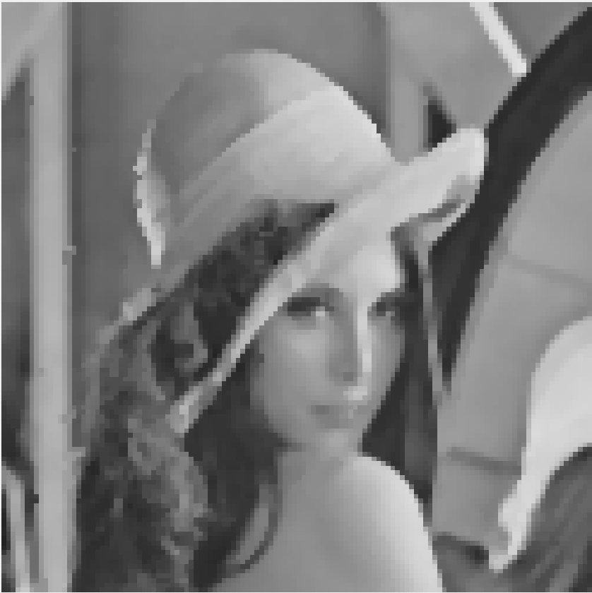
MATLAB Output
Hardware Output
Without Noise
With Noise
Notes:
anushka

Slide 32
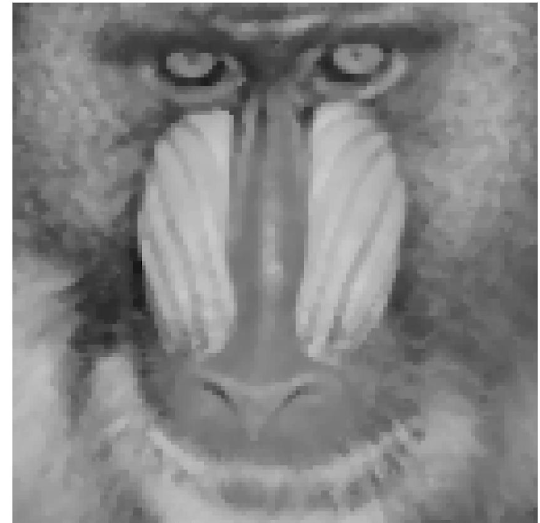
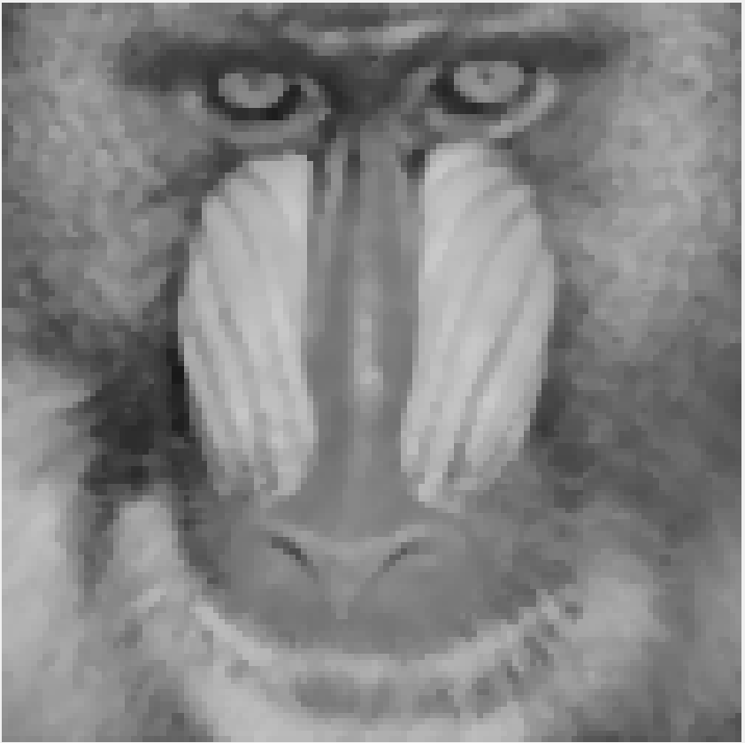


MATLAB Output
Hardware Output
Baboon
Cameraman
Notes:
anushka

Slide 33
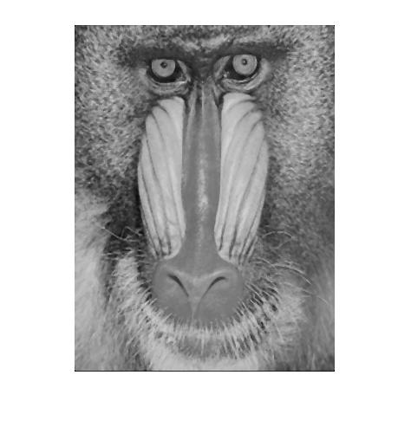
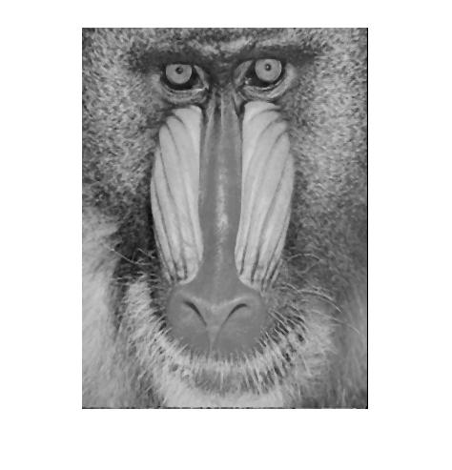
Images with Variable Size
MATLAB Output
Hardware Output
Notes:
anushka

Slide 34
Conclusion
We have successfully implemented the Median Filter on the Zedboard and AWS. We have verified the speedup in comparison to C++ Software execution.
Pixel by pixel verification was done to compare the hardware and the MATLAB outputs.
SW and HW Emulation times were compared when implemented on AWS EC2 F1 instance.
Based on the Results obtained we observe a 8.9x speed increase in the hardware implementation compared to the C++ Software implementation and 131.64 speedup was observed between the SW and HW emulations.
Notes:
Medini

